Slide 1
Environmental Knowledge Management System (E.K.M.S)
Technical rehearsal training workshop
By : U-JAY VAH, TROKON A. SAYKPA & ELVINA SAMUELS
EKMS TEAMS

Slide 2
Outline of Lecture/Presentation
Component and Tools of the EKMS
Using the URL to Find the EKMS Website
Exploring & Navigating the EKMS
Overview of the EKMS Back-end
Edit & Uploading contents
Working with components and tools
Secure Cloud drive
Community Forum
FAQs, etc
Bulletin Board
7. Questions & Answers

Slide 3
Key Components/Tools of the E.K.M.S
EKMS - design consists different components and tools.
Components
TOOLS
EKMS Main website
Cloud Drive
Community Forum
EKMS Bulletins
Online Video Conferencing
FAQs
Live Chat

Slide 4
MAIN WEBSITE OF THE E.K.M.S
EKMS main website was designed using WordPress Content Management System.
Wordpress
Evoq content
Plone
Square Space

Slide 5
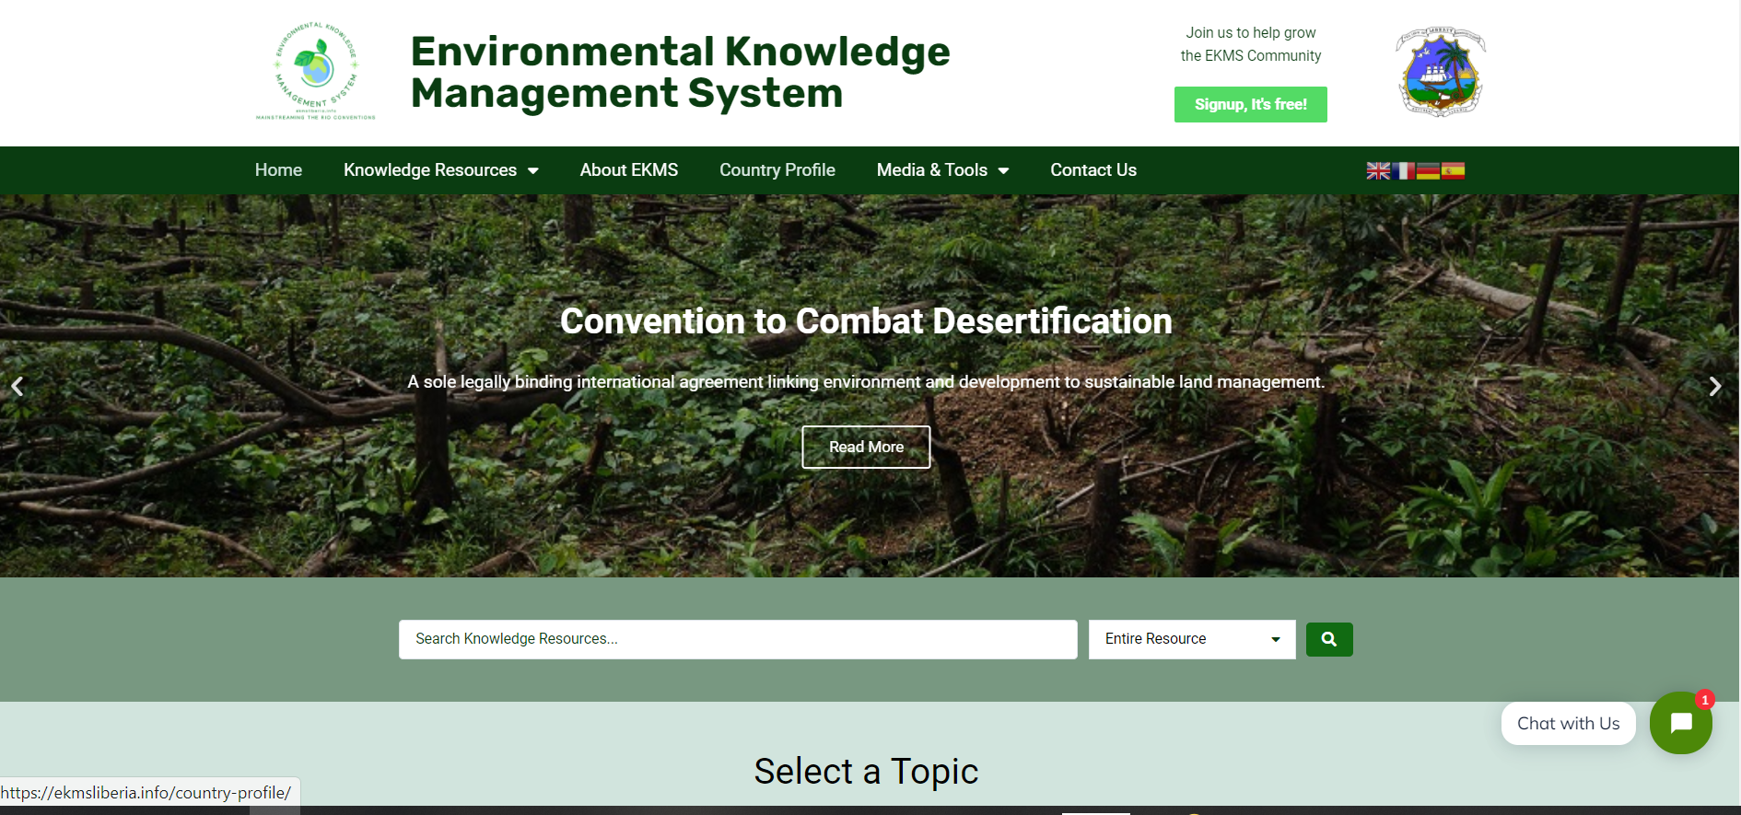
The EKMS main website can be access using the below link:
URL - https://ekmsliberia.info

Slide 6
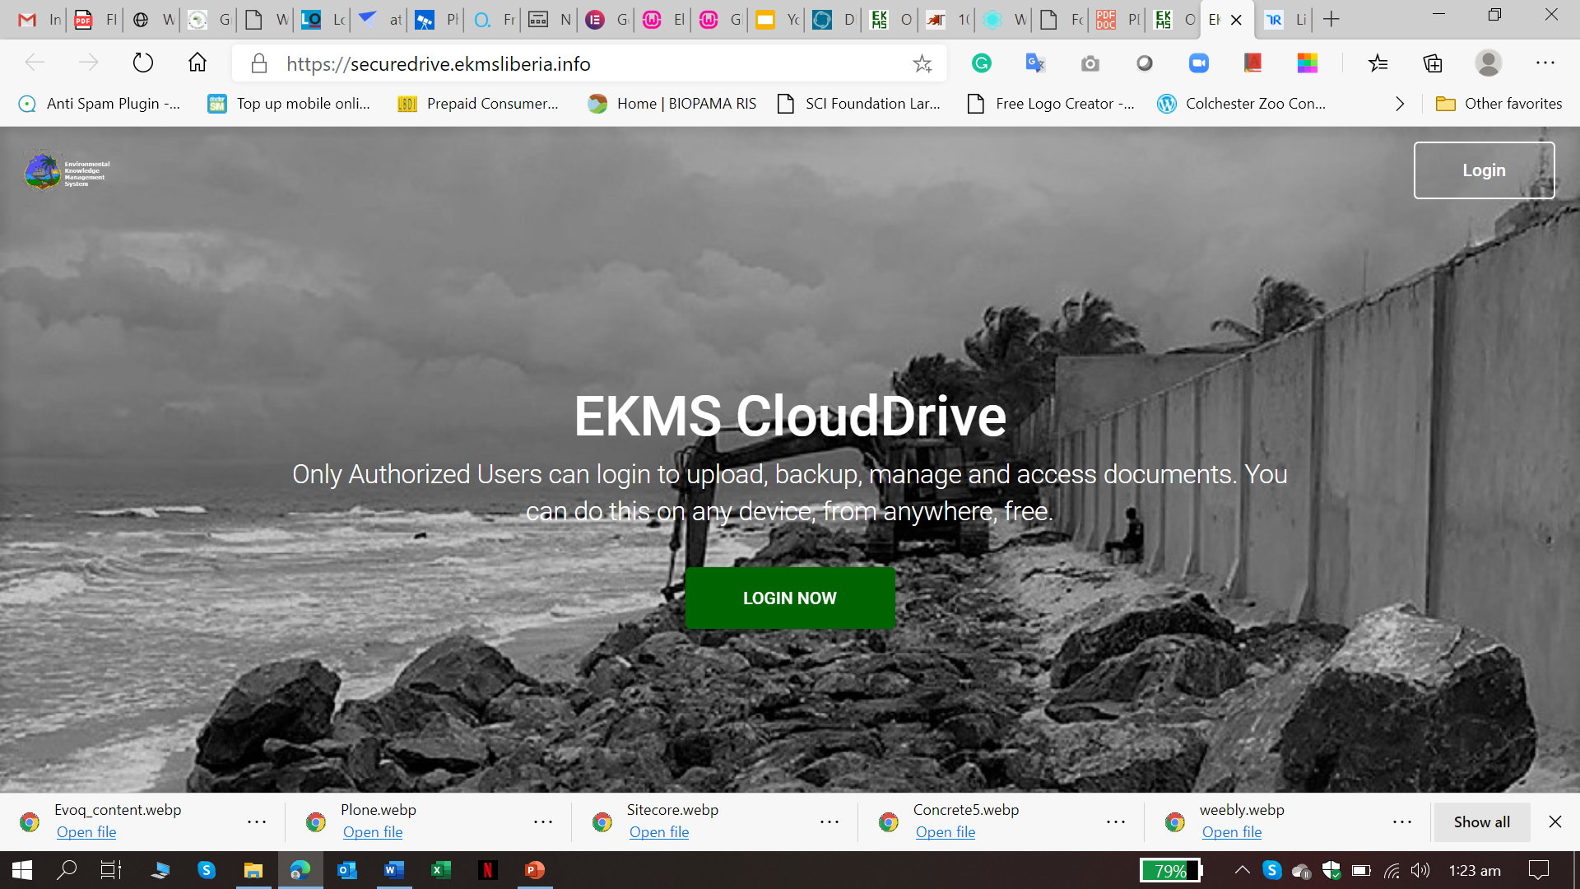
CLOUD DRIVE OF THE EKMS
A component of the EKMS – CLOUD DRIVE
Authorized Users can login to a Secure Cloud Drive to upload documents and other important contents for the EKMS.

Slide 7
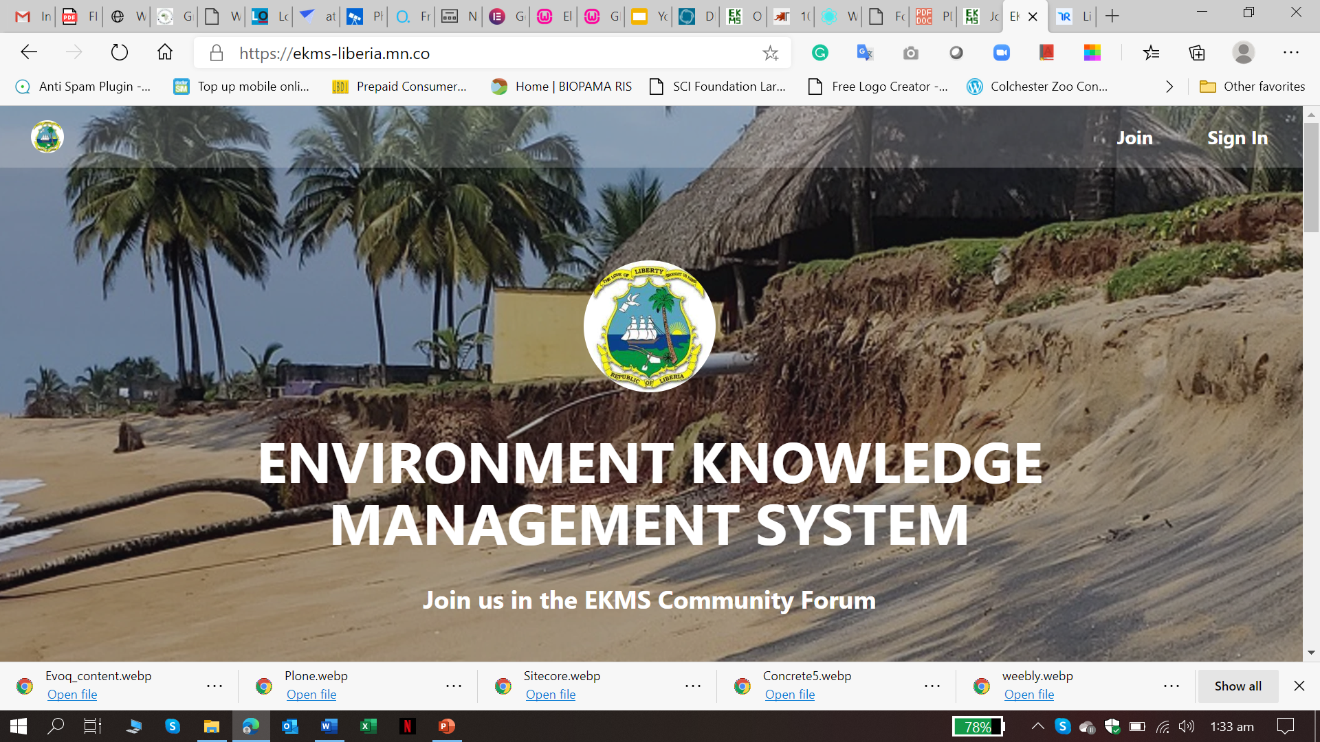
EKMS COMMUNITY FORUM
Users can join the community discussion forum; add topics for discussion, comment on existing topics or issues relating to Biodiversity, Climate Change and/or Desertification.

Slide 8
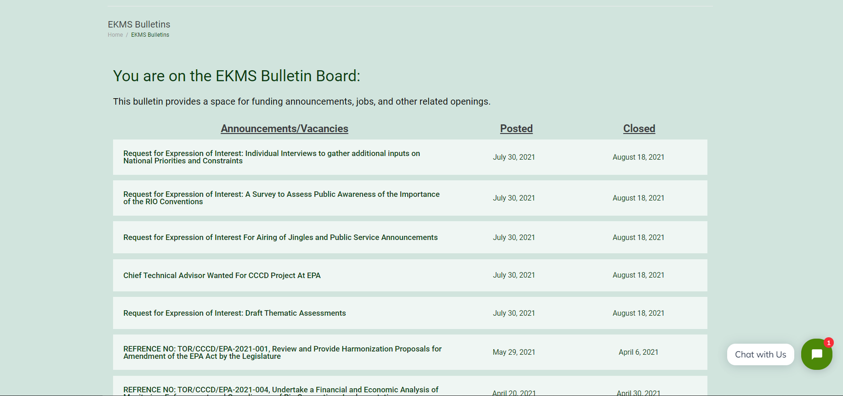
EKMS BULLETINS
A tool of the EKMS – BULLETINS
A space for funding announcements, jobs, and other related openings.

Slide 9
ONLINE VIDEO CONFERENCING
Authorized users can setup an online meeting with colleagues from the same or several organizations. They can meet virtually to discuss issues especially relating to the implementation of the RIO Conventions.

Slide 10
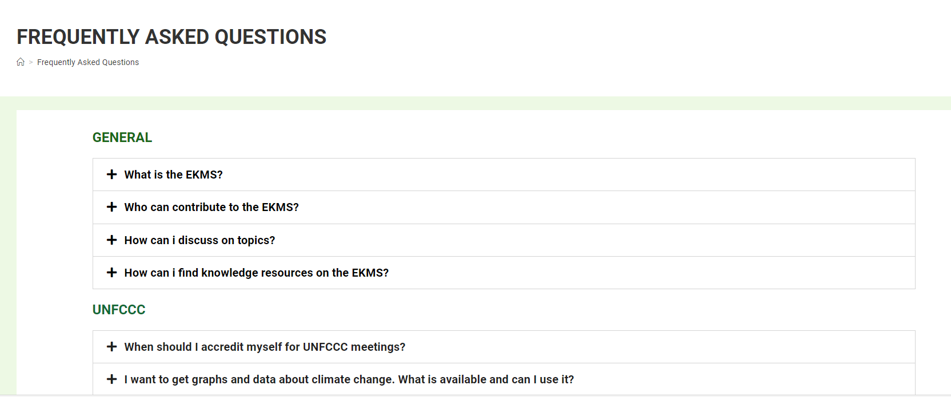
EKMS FAQs
FAQs – Frequently Asked Questions

Slide 12
Exploring & Navigating EKMS
The EKMS main website can be access using the below link:
https://ekmsliberia.info

Slide 13
The EKMS Look and Feel – Frontpage or Home

Slide 14
Home - Frontpage
Main features on home or frontpage
Smartsearch bar
Explore Topics
Explore Institutions
Explore Documents
Join the community forum
News
Contribute to the EKMS
Live Chat

Slide 15
Knowledge Resources
Main Features
Multilateral Agreements
Convention topics
All Institutions involved
All documents on system

Slide 16
About EKMS
Why the EKMS was created?
Strategies
Challenges
Who Funded this?
Etc
Country Profile
Brief profile outlining some information about Liberia

Slide 17
Media & Tools
Key features for Media & Tools
News & Blogs
EKMS Bulletins
FAQs
Maps
Join the community
Startup online meetings
EKMS Clouddrive

Slide 18
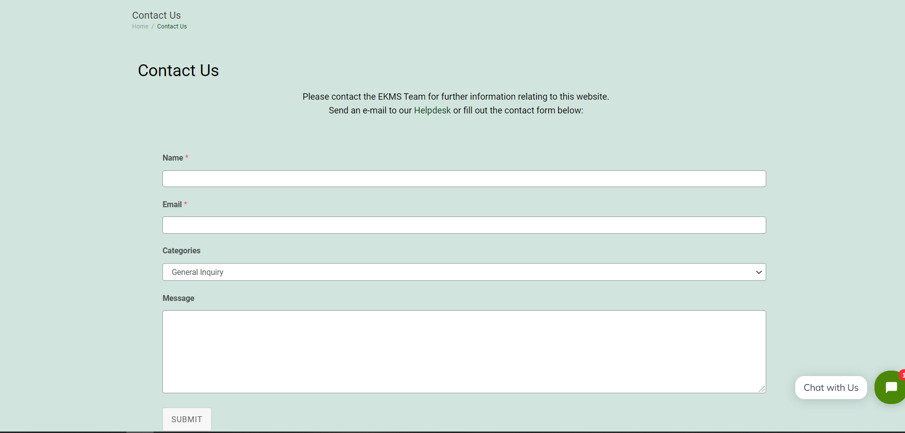
Contact
- Send a short message to the EKMS manager

Slide 19
Other Menu and Features
Contributing to EKMS
EKMS Newsletter
Security
Social media pages (Facebook & Twitter)
Change site language

Slide 21
THANK YOU

